Slide 1
Linear Algebra
Lecture 37

Slide 2
Linear Algebra
Lecture 37

Slide 3
Revision
Lecture II

Slide 4
Systems of
Linear Equations

Slide 5
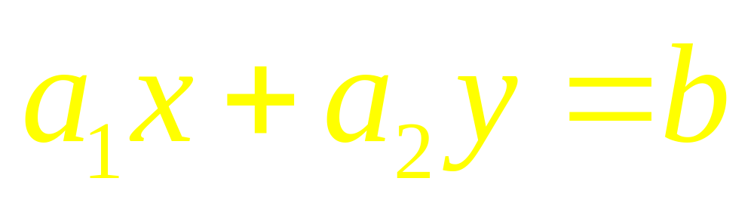
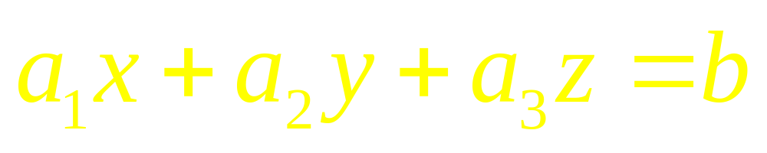
Examples of
Linear Equations

Slide 6
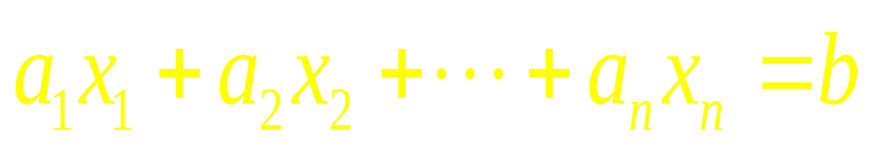
Generally
An equation in n-variables
or in n-unknowns

Slide 7
Linear System
A finite set of linear equations is called a system of linear equations or linear system. The variables in a linear system are called the unknowns.

Slide 8
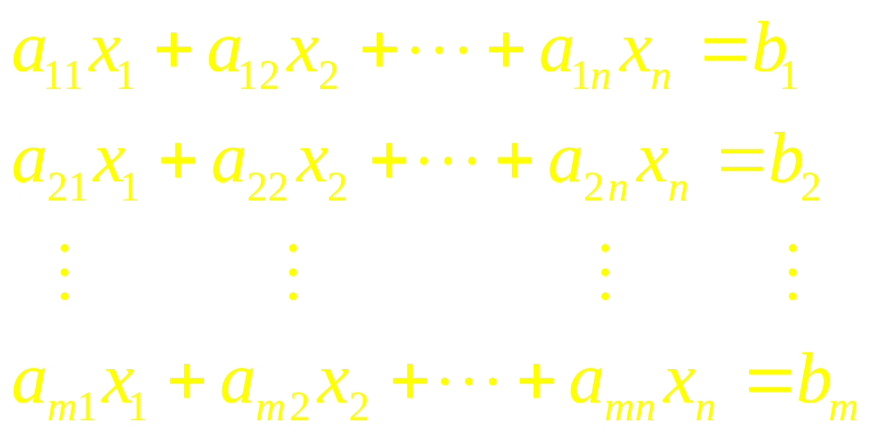
Linear System

Slide 9
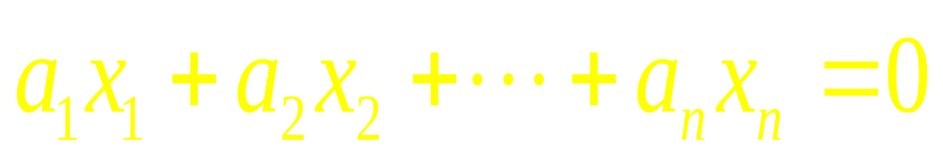
Homogenous
Linear Equations
If b=0

Slide 10
Theorem
Every system of linear equations has zero, one or infinitely many solutions; there are no other possibilities.

Slide 11
Row Reduction and
Echelon Form

Slide 12
Echelon Form
All nonzero rows are above any rows of all zeros.
Each leading entry of a row is in a column to the right of the leading entry of the row above it.
All entries in a column below a leading entry are zero.

Slide 13
Reduced Echelon Form
The leading entry in each nonzero row is 1.
Each leading 1 is the only non-zero entry in its column.

Slide 14
Theorem
Each matrix is row equivalent to one and only one reduced echelon matrix

Slide 15
Row Reduction Algorithm
Row Reduction Algorithm consists of four steps, and it produces a matrix in echelon form.
A fifth step produces a matrix in reduced echelon form.
…

Slide 16
STEP 1
Begin with the leftmost nonzero column. This is a pivot column. The pivot position is at the top.
STEP 2
Select a nonzero entry in the pivot column as a pivot. If necessary, interchange rows to move this entry into the pivot position
…

Slide 17
STEP 3
Use row operations to create zeros in all positions below the pivot
STEP 4
Cover (ignore) the row containing the pivot position and cover all rows, if any, above it
Apply steps 1 –3 to the sub-matrix, which remains.
Repeat the process until there are no more nonzero rows to modify

Slide 18
Vector
Equations

Slide 19
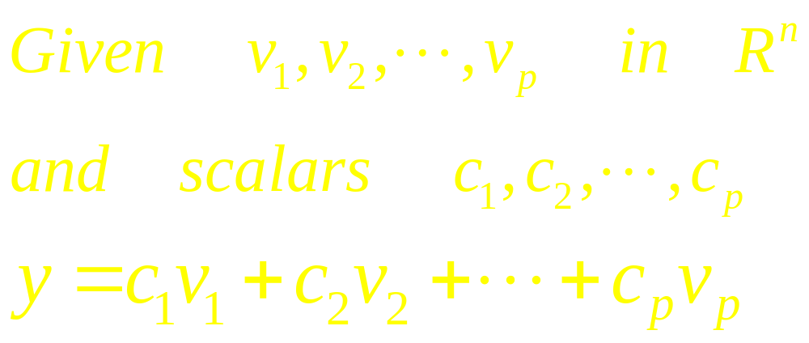
Linear Combination

Slide 20
Definition
If v₁, . . . , v_{p} are in R^{n}, then the set of all linear combinations of v₁, . . . , v_{p} is denoted by Span {v₁, . . . , v_{p} } and is called the subset of R^{n} spanned (or generated) by v₁, . . . , v_{p} .
…

Slide 21
That is, Span {v₁, . . . , v_{p} } is the collection of all vectors that can be written in the form c₁v₁ + c₂v₂ + …. + c_{p}v_{p}, with c₁, . . . , c_{p} scalars.

Slide 22
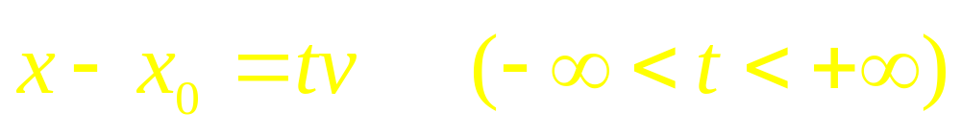
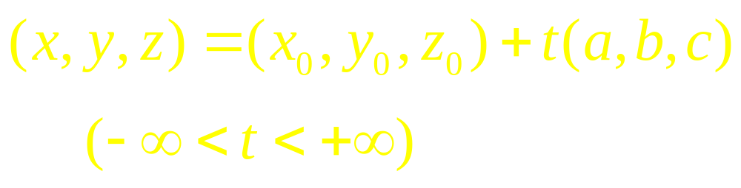
Vector and Parametric Equations of a Line

Slide 23
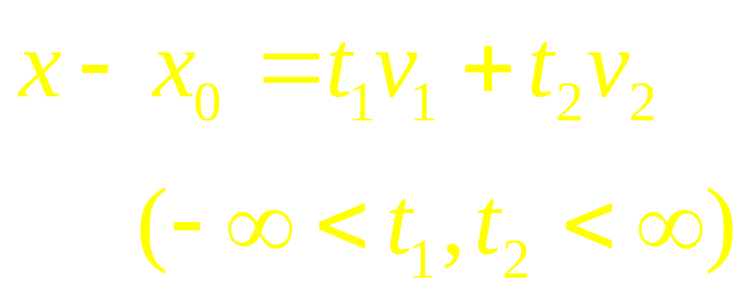
Vector and Parametric Equations of a Plane

Slide 24
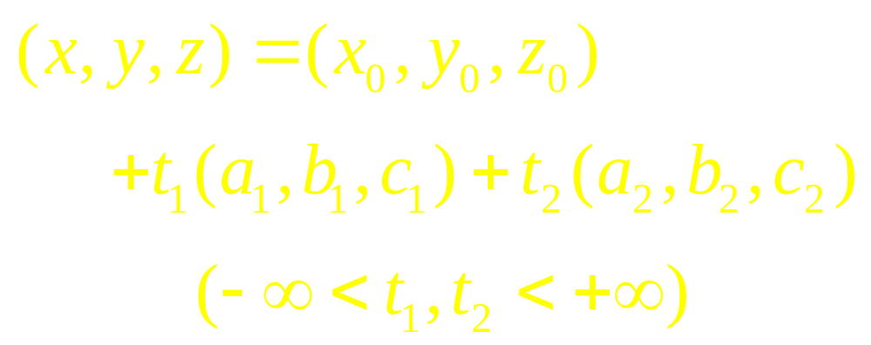
Vector and Parametric Equations of a Plane

Slide 25
Matrix
Equations

Slide 26
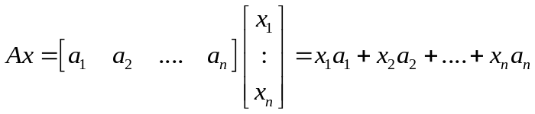
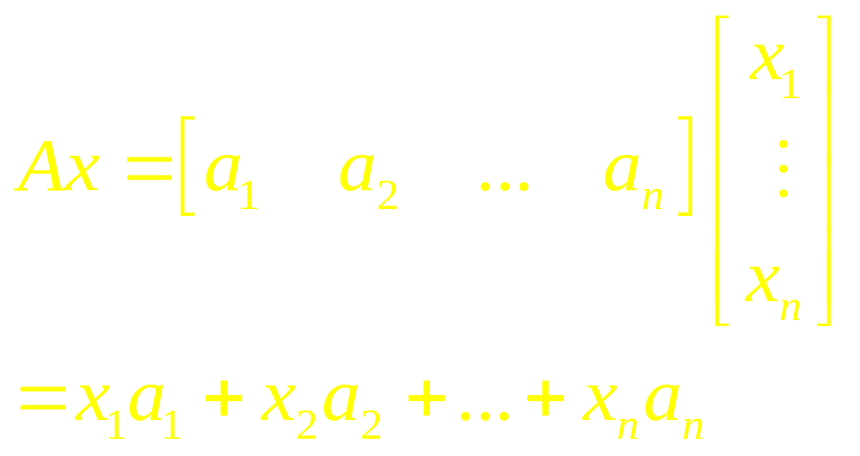
Definition

Slide 27
Existence of Solutions
The equation Ax = b has a solution if and only if b is a linear combination of the columns of A.

Slide 28
Theorem
Let A be an mxn matrix. Then the following statements are logically equivalent. That is, for a particular A, either they are all true statements or they are all false.
…

Slide 29
Continued
For each b in R^{m}, the equation Ax = b has a solution.
The columns of A Span R^{m}.
A has a pivot position in every row.

Slide 30
Theorem
Let A be an mxn matrix, u and v are vectors in R^{n}, and c is a scalar, then
1. A ( u + v ) = Au + Av
2. A (cu) = c A (u)

Slide 31
Solution Set of
Linear Systems

Slide 32
Homogenous
Linear Systems
A system of linear equations is said to be homogeneous if it can be written in the form Ax = 0, where A is an mxn matrix and 0 is the zero vector in R^{m}

Slide 33
Trivial Solution
Such a system Ax = 0 always has at least one solution, namely, x = 0
(the zero vector in R^{n}).
This zero solution is usually called the trivial solution.

Slide 34
Non Trivial Solution
The homogeneous equation Ax = 0 has a nontrivial solution if and only if the equation has at least one free variable.

Slide 35
Solutions of Non-homogenous Systems
When a non-homogeneous linear system has many solutions, the general solution can be written in parametric vector form as one vector plus an arbitrary linear combination of vectors that satisfy the corresponding homogeneous system.

Slide 36
Parametric Form
The equation
x = p + tv (t in R)
describes the solution set of Ax = b in parametric vector form.

Slide 37
Linear
Independence

Slide 38
Definition
An indexed set in R^{n} is said to be linearly independent if the vector equation x₁v₁+x₂v₂+…+x_{p}v_{p}=0
has only the trivial solution.

Slide 39
Important Fact
The columns of a matrix A are linearly independent if and only if the equation Ax = 0 has only the trivial solution.

Slide 40
Linear
Transformations

Slide 41
A transformation T from R^{m} is a rule that assigns to each vector x in R^{n} a vector T(x) in R^{m} . The set R^{n} is called the domain of T, and R^{m} is called the co-domain of T.

Slide 42

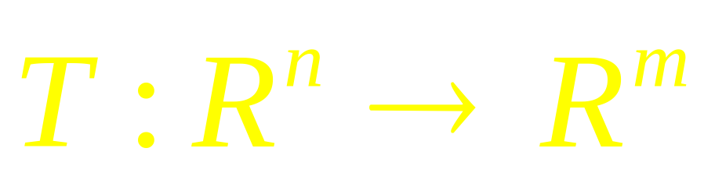
The notation
indicates that the domain of T is R^{n} and the co-domain is R^{m}. For x in R^{n} , the vector T(x) in R^{m} is called the image of x (under the action of T). The set of all images T(x) is called the range of T

Slide 43
Definition
A transformation (or mapping) T is linear if:
T(u + v) = T(u) + T(v) for all u, v in the domain of T;
T(cu) = cT(u) for all u and all scalars c.

Slide 44
Further
If T is a linear transformation, then T(0) = 0, and
T(cu +dv) = cT(u) + dT(v)
for all vectors u, v in the domain of T and all scalars c, d.

Slide 45
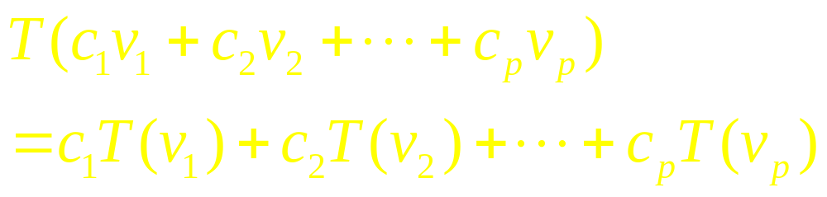
Generally

Slide 46
The Matrix
of a Linear
Transformations

Slide 47
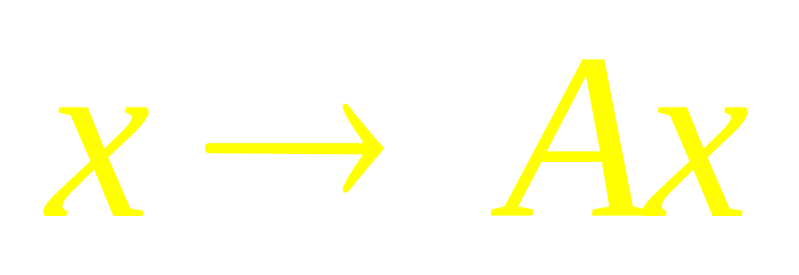
Every Linear Transformation from R^{n} to R^{m} is actually a matrix Transformation

Slide 48
Theorem
Let
be a linear transformation. Then there exist a unique matrix A such that T(x)=Ax for all x in R^{n}.

Slide 49
Linear Algebra
Lecture 37

